Slide 1
Safety Trends in Large Scale Lithium-Ion Battery Energy Storage Systems
August 11, 2021
Presented by:
Chris Wright
Executive Director – Energy Storage

Slide 2
Agenda
Introduction
Energy Storage
Lithium-Ion Battery Technology
Recent and Notable Lithium-Ion Events
Safety Trends
Chemistry and Battery Cells
Battery Systems
Hazard Analysis and Large-Scale Fire Testing
Relevant Safety Standards

Slide 3
Presentation Overview:
Introduction

Slide 4
Chris Wright
Executive Director, Energy Storage
15+ years of experience in renewable energy; including Project Development, Operations, Engineering, Procurement and Construction
Performed technical due diligence on numerous emerging energy storage and battery technologies while at NextEra Energy
Led various engineering, procurement and construction efforts for over 650 megawatts of solar, wind and energy storage projects in six countries
MS in Engineering from the University of Toledo, BS from the University of West Florida

Slide 5
Presentation Overview
The global stationary energy storage market continues to adopt lithium-ion (Li-ion) battery technology at an exponential rate.
Today, I will provide some background on Li-Ion battery technology, review some major trends in safety, and discuss the major standards driving energy storage safety.

Slide 6
Energy Storage The Changing Electrical Grid

Slide 7
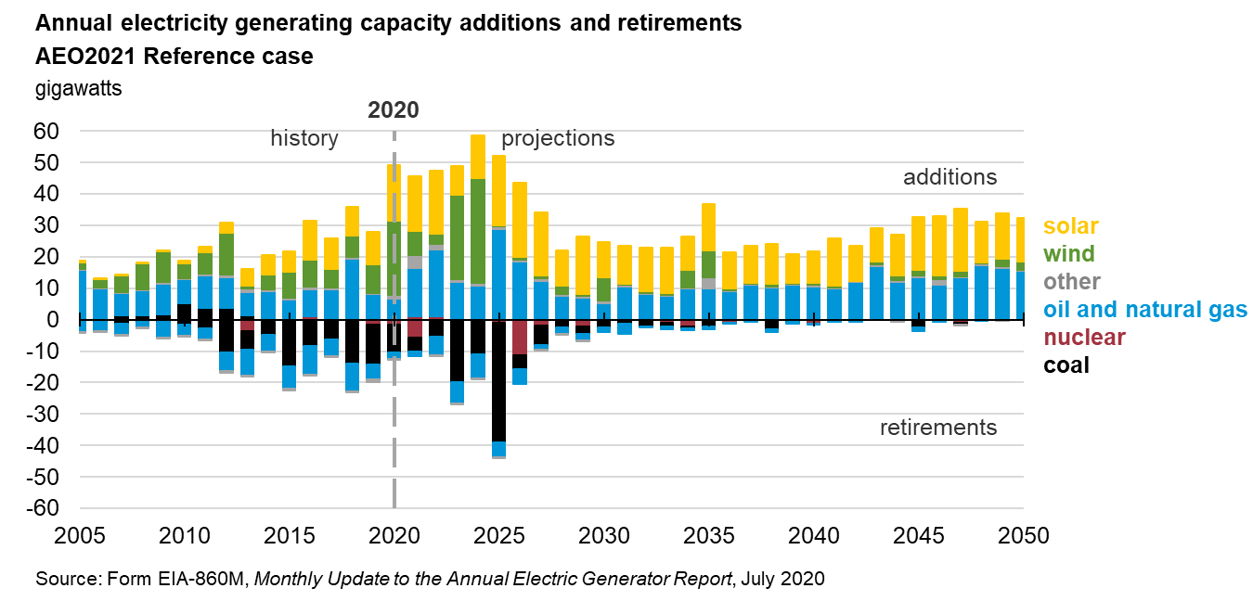
Where Are We Going?

Slide 8
How Will We Get There?
Energy storage will enable the widespread and reliable integration of renewable generation into the electric grid
While Long Duration Storage (LDES) technologies are being developed, lithium-ion technology is expected to hold >80% of the stationary storage market share for at least the next few years

Slide 9
Lithium-Ion Batteries
How do they Work?
Cell Types
Common Chemistries
Abuse Factors
Thermal Runaway

Slide 10
HOW DO THEY WORK?
Li-Ion Technology
Lithium-Ion Batteries operate by transporting Li+ ions to the anode structure during charging and then by shuttling the same ions across a porous separator via the electrolyte to the cathode structure on discharge.
The need to maintain charge balance at each electrode drives a current through an external circuit, performing work.
Notes:
Lithium-Ion Batteries operate by transporting Li+ ions to the anode structure during charging and then by shuttling the same ions across a porous separator via the electrolyte to the cathode structure on discharge.
The need to maintain charge balance at each electrode drives a current through an external circuit, performing work.

Slide 11
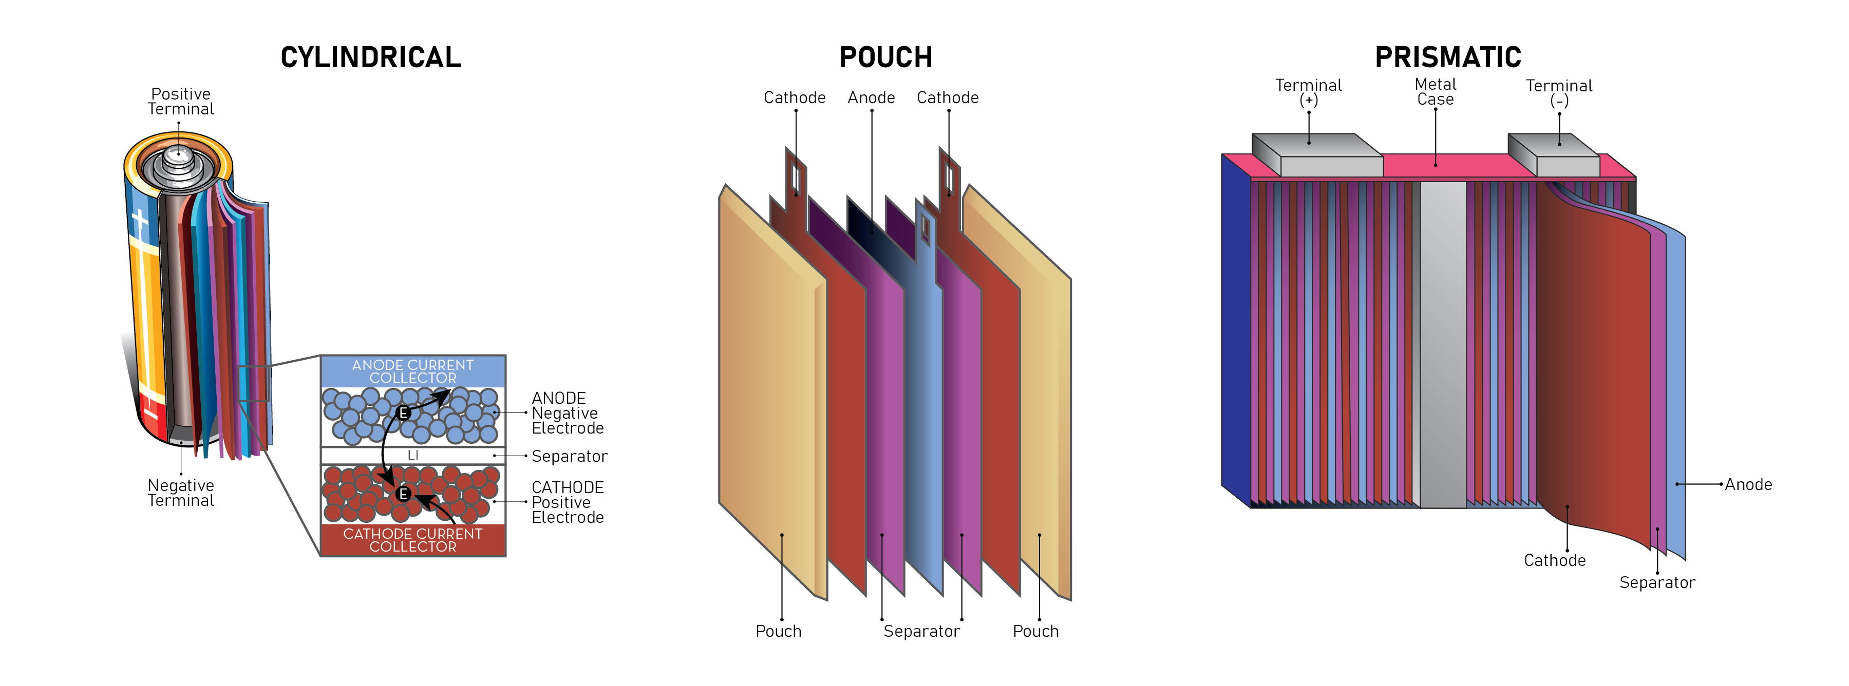
BATTERY CELL TYPES
Li-Ion Technology
A basic cell consists of two electrodes within an electrolyte. The electrodes are electrically separated from each other with the use of a separator. The entire assembly of the electrodes, separator and electrolyte – along with conductive current collectors – is confined within a container. The electrochemical reactions are set in motion when the terminals of the cell are connected to an external load. Aluminum (Al) and Copper (Cu) serve as the current collectors at the electrodes
Notes:
A basic cell consists of two electrodes within an electrolyte.
The electrodes are electrically separated from each other with the use of a separator.
The entire assembly of the electrodes, separator and electrolyte – along with conductive current collectors – is confined within a container.
The electrochemical reactions are set in motion when the terminals of the cell are connected to an external load. Aluminum (Al) and Copper (Cu) serve as the current collectors at the electrodes

Slide 12
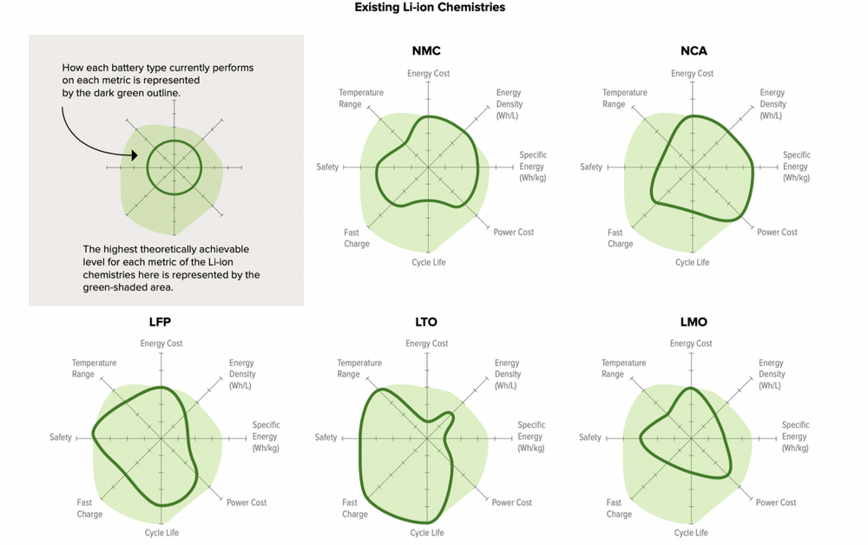
LITHIUM-ION COMMON CHEMISTRY COMPARISON
Li-Ion batteries are named for their active materials which are either written out or shortened by their chemical symbols. These series of letters and numbers are often abbreviated to make them easier to write and understand. When cobalt is the main active material, the term Lithium-Cobalt will often be used. Lithium-Ion battery cells typically consist of a graphite anode, metal-oxide cathode and a Lithium salt electrolyte gel.
There are three main lithium-ion battery chemistries being used for grid storage: LFP, NMC and NCA.
Li-Ion Chemistries
Increasing the battery energy density is key for passenger Electric Vehicles adoption since it provides additional range. Nickel based chemistries like Nickel Manganese Cobalt (NMC) were commonly used for stationary energy storage over the past ten years.
However, high volume production and technology advances driven by the Electric Bus market has pushed Lithium Iron Phosphate (LFP) into the forefront of stationary energy storage projects worldwide.
Notes:
Increasing the battery energy density is key for passenger Electric Vehicles adoption since it provides additional range. Nickel based chemistries like Nickel Manganese Cobalt (NMC) were commonly used for stationary energy storage over the past ten years.
However, high volume production and technology advances driven by the Electric Bus market has pushed Lithium Iron Phosphate (LFP) into the forefront of stationary energy storage projects worldwide.

Slide 13
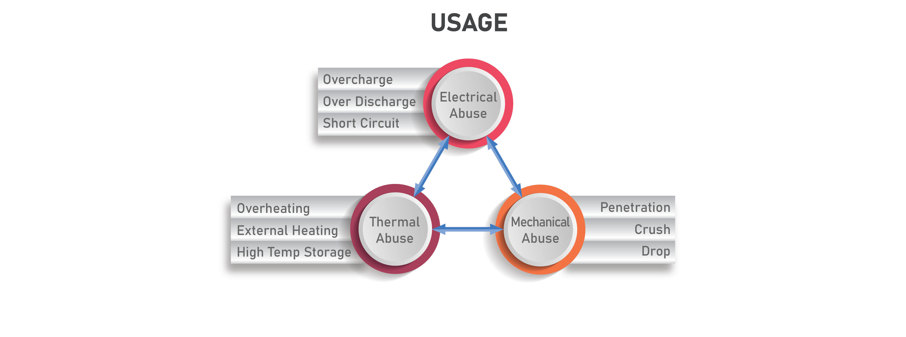
USAGE ABUSE FACTORS
Li-Ion Technology
Proper monitoring, testing and control can mitigate potential hazards; however, lithium-ion batteries often fail when exposed to “abuse factors.” The primary concern is an energetic failure, resulting in “thermal runaway” of the cell and subsequent system.
Notes:
There are three main ‘abuse factors’, or initiators to failure, for lithium-ion batteries
Electrical: overcharging, over discharging
Mechanical: nail penetration, crush, excessive forces during mfg
Thermal: overheating, high temp storage
Various testing standards are developed to assess a battery cell’s behavior under these conditions.
We typically focus on electrical and thermal abuse factors for ESS, but mechanical abuse risks exist, esp during installation

Slide 14
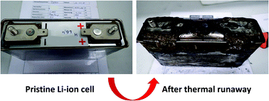
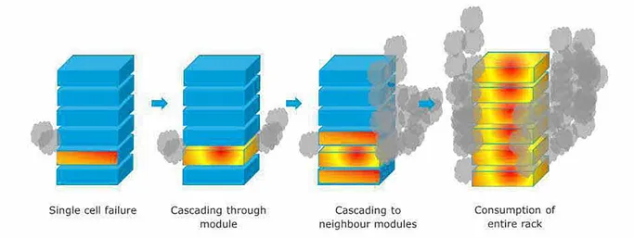
THERMAL RUNAWAY AND PROPAGATION
What is thermal runaway?
Thermal runaway of a lithium-ion battery cell occurs when the heat generated by the battery cell exceeds the cell's ability to dissipate. The temperature rises rapidly within milliseconds and the energy stored in the battery is suddenly released. Once internal temperature exceeds the electrolyte rating, the electrolyte can become gaseous, and explosive gasses may be released.
In an enclosed (unventilated) area, this decomposed electrolyte gas can build up and cause an explosion.
Source: RSC Advances, “Thermal runaway of large automotive Li-ion batteries“
What is propagation?
Thermal runaway of a single battery cell can be contained to that cell, however if the thermal runaway of a single cell can initiate thermal runway of adjacent cells, propagation can occur, and a chain reaction may begin.
Propagation of cell-to-cell and module-to-module can lead to catastrophic failure of the system and endanger nearby equipment and responders.
Source: APS report, McMicken BESS Event
Notes:
Thermal runaway:
Thermal runaway of a lithium-ion battery cell occurs when the heat generated by the battery cell exceeds the cell's ability to dissipate. The temperature rises rapidly within milliseconds and the energy stored in the battery is suddenly released. Once internal temperature exceeds the electrolyte rating, the electrolyte can become gaseous, and explosive gasses may be released.
In an enclosed (unventilated) area, this decomposed electrolyte gas can build up and cause an explosion.
Propagation
Thermal runaway of a single battery cell can be contained to that cell, however if the thermal runaway of a single cell can initiate thermal runway of adjacent cells, propagation can occur, and a chain reaction may begin.
Propagation of cell-to-cell and module-to-module can lead to catastrophic failure of the system and endanger nearby equipment and responders.

Slide 15
Lithium-Ion Safety Events Stationary Energy Storage Systems
Electric Vehicles

Slide 16
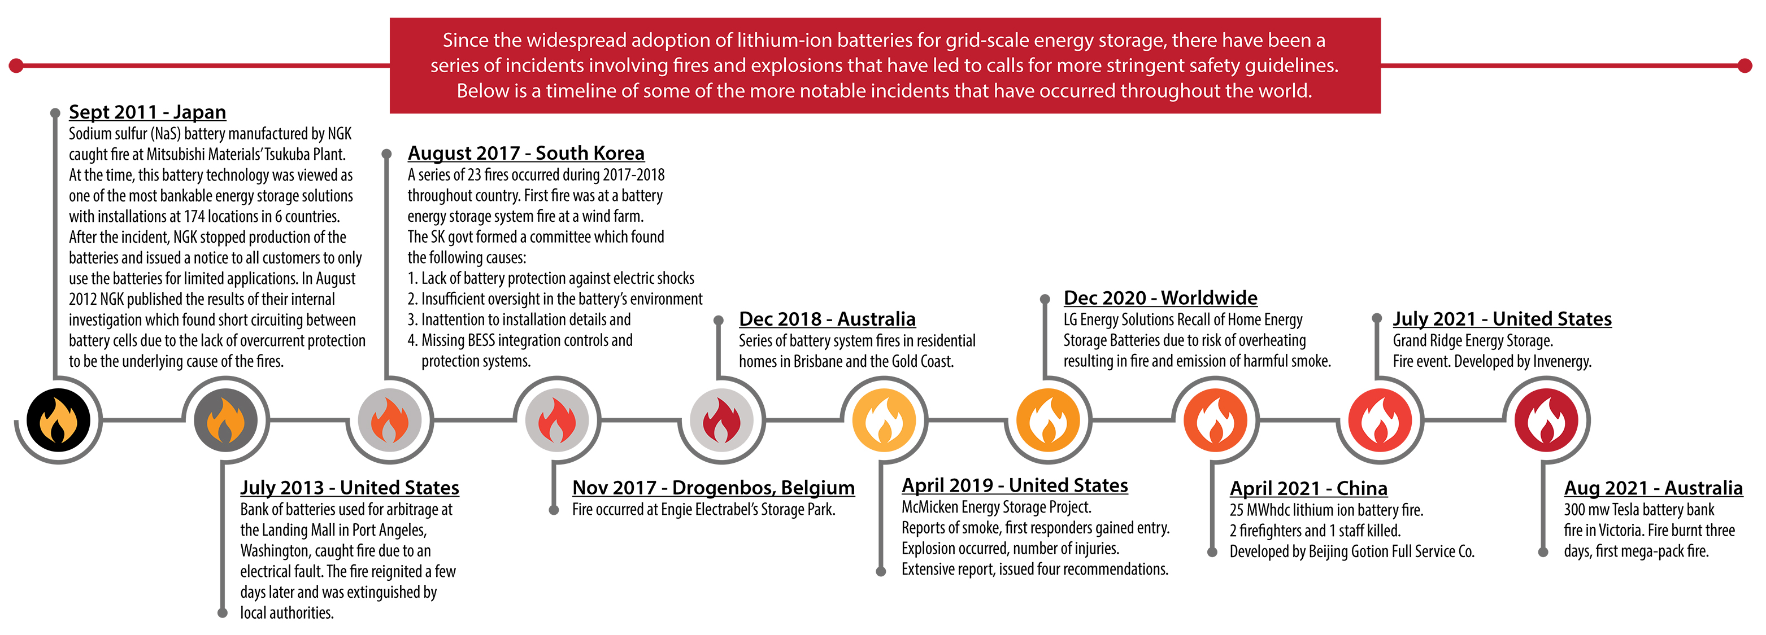
NOTABLE EVENTS - STATIONARY STORAGE

Slide 17
RECENT EVENTS – ELECTRIC VEHICLES

Slide 18
Safety Trends – Chemistry and Battery Cells
Cell Packaging
Cell Chemistry
Electrolytes
Separators
Modules

Slide 19
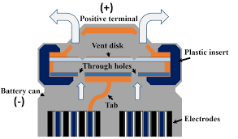
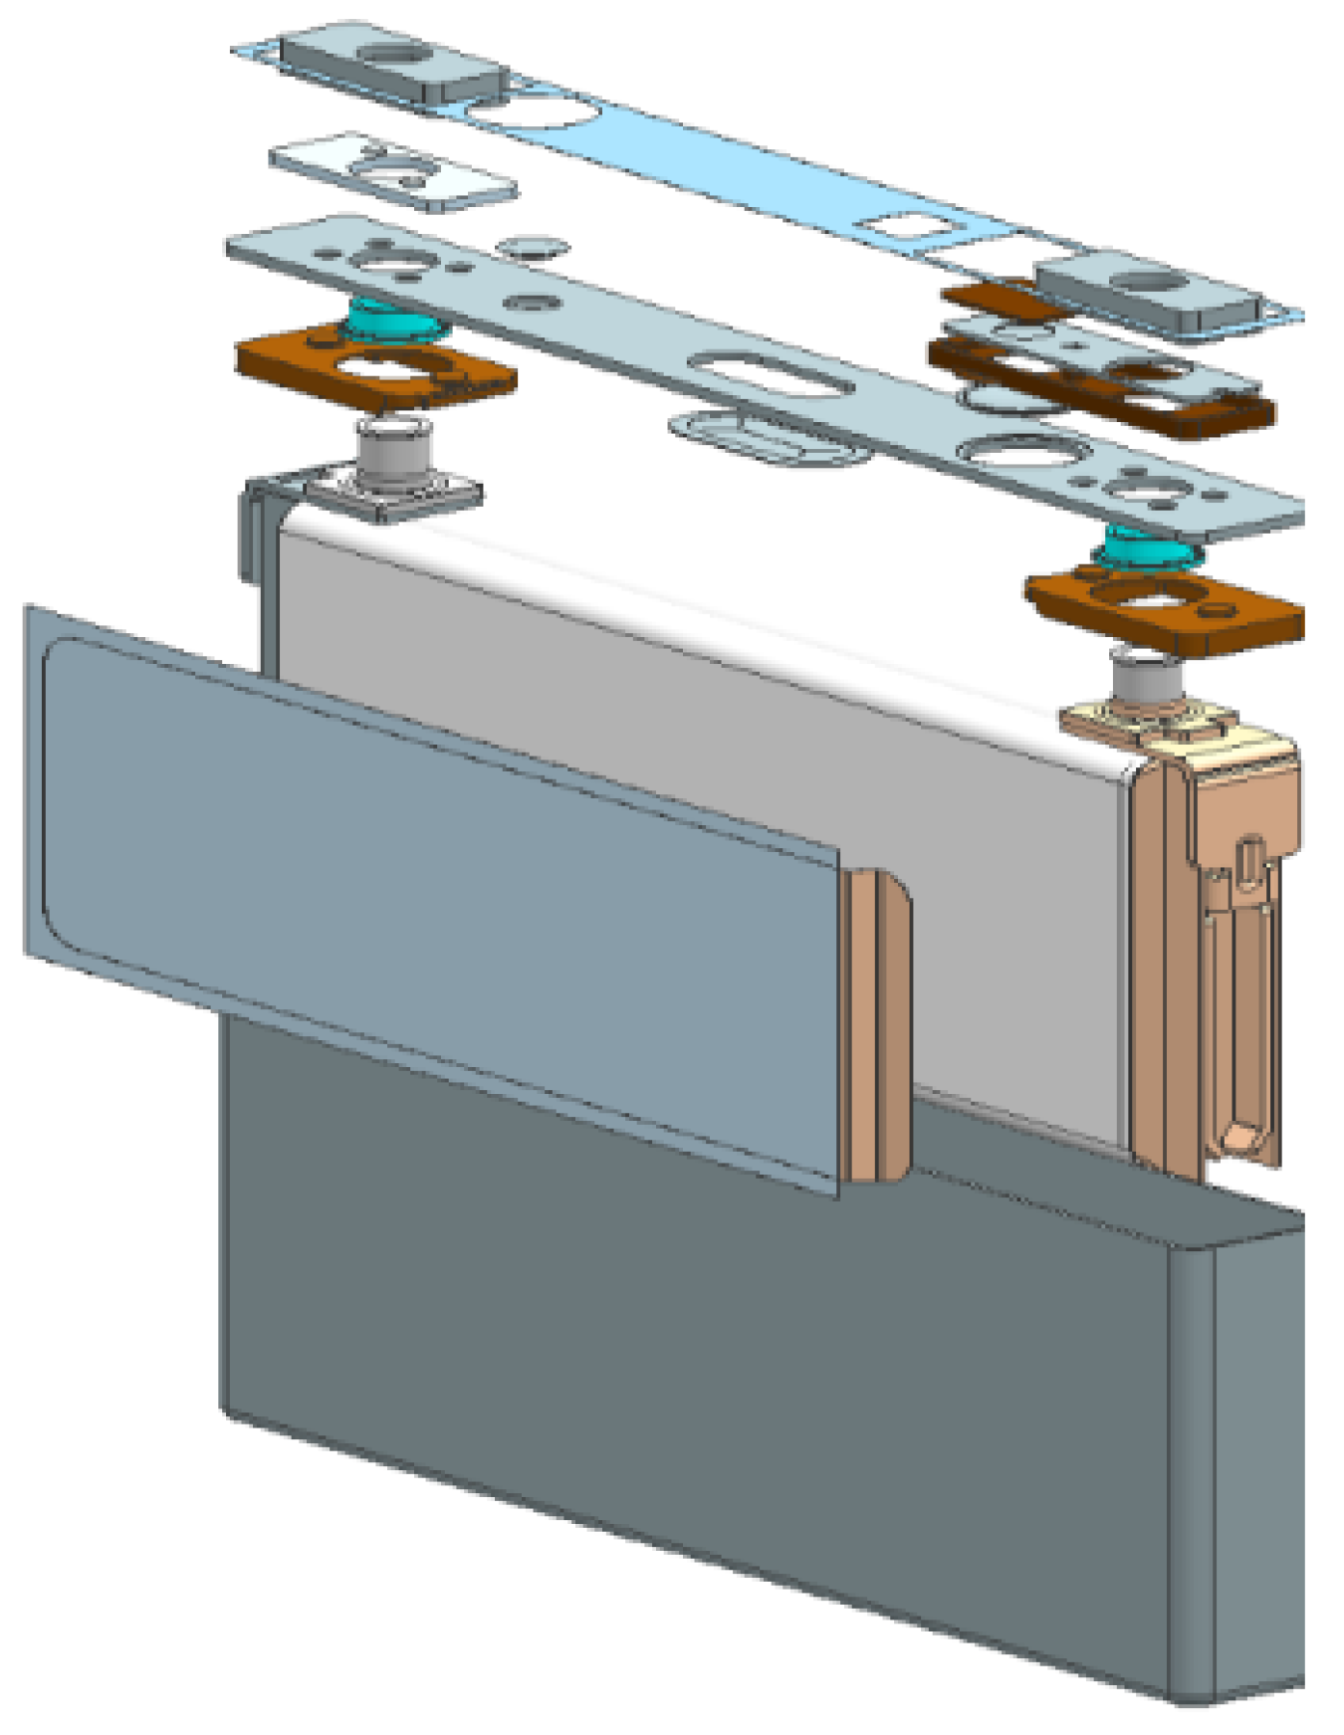
CELL PACKAGING SAFETY MECHANISMS
Burst Disk
Initiated by high inner pressure, will break open when internal pressure exceeds a threshold and releases gas.
Overcharge Safety Device
OSD membrane breaks the circuit open once the cell’s inner pressure threshold is reached, by creating an external short circuit event to trigger the to stop battery cell from further charging/discharging operations.
Thermal Fusing
Internal fuse opens when temperature or current exceeds threshold. Removes the cell from further charging/discharging operations.
Nail Safety Device
Metal sheet is used as the nail safety device to protect inner cell components from nail penetration. During a short circuit event, NSD sheet can dilute the current flow to avoid overheating from the concentrated current flow.

Slide 20
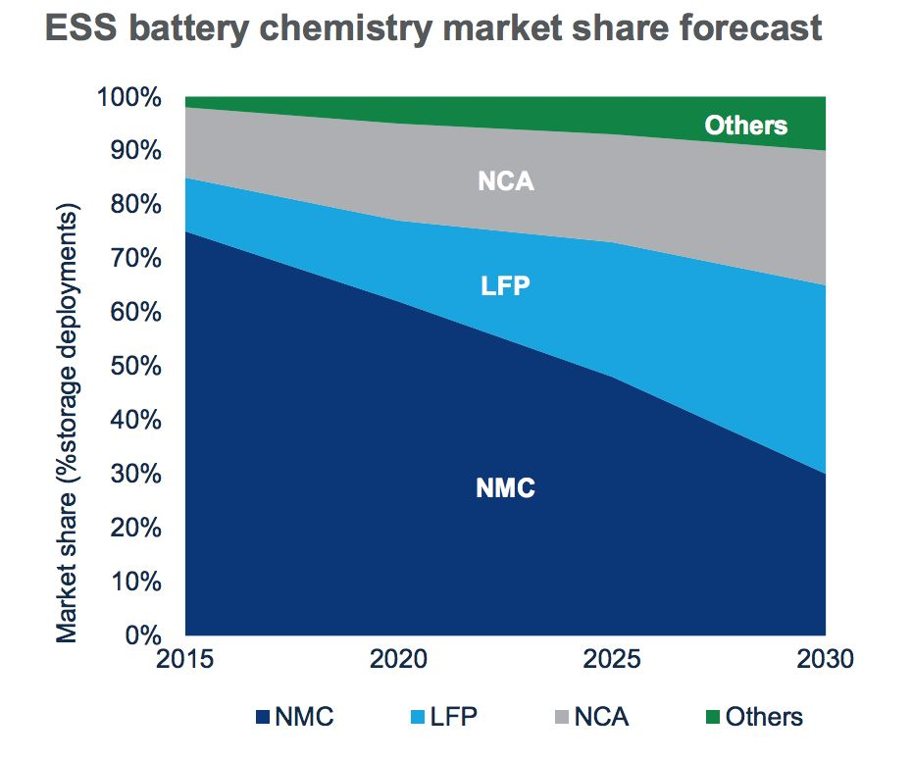
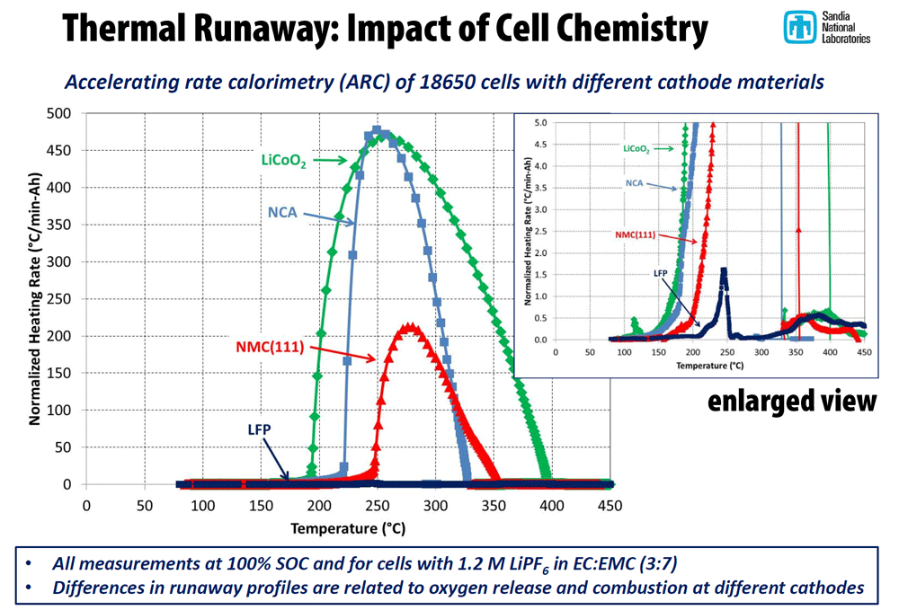
CELL CHEMISTRY – LITHIUM IRON PHOSPHATE
Lithium Iron Phosphate, or ‘LFP’, is known as more stable chemistry, which means the temperature threshold for thermal runaway (or fire) is higher than that of NCM
Source: WoodMac
Due to its significantly decreased risk of thermal runaway when compared to nickel-based cathodes and the abundance of primary raw materials - LFP expected to be the predominant chemistry for ESS
Notes:
LFP was highly utilized in China by the EV bus industry due to its inherent safety against thermal runaway.
LFP’s thermal runaway behavior does not release as much heat as the nickel-based chemistries, significantly reducing the risk of a thermal propagation event.
LFP market share is continually increasing in stationary storage primarily due to; safety, lower mfg costs and EV demand for higher energy dense chemistries.

Slide 21
ELECTROLYTE DESIGN
Reducing the risk of flammable organic solvents from traditional electrolytes is key to increased safety. Many researchers believe that liquid electrolytes have inherent safety disadvantages that can not be sufficiently resolved.
Additionally, lithium dendrites are still a possibility using liquid electrolyte. So future research has focused on solid-phase (i.e. ‘solid state’) electrolytes.
The solid-state and polymer electrolyte technologies represent the major advancement in next-generation lithium-ion batteries. Batteries constructed using these electrolytes use either a gelled electrolyte or a solid polymer electrolyte. Organic solvents are eliminated or greatly reduced in polymer electrolytes, greatly reducing or eliminating this hazard and increasing the safety of the cell.
High cost and low ionic conductivity of polymer electrolytes remain substantial barriers to commercialization.
Semi-solid electrolytes are also in development, these may offer increased performance when compared to the solid-state version while also increasing safety
Notes:
Reducing the release of flammable solvents is the key safety-related key design goal for electrolyte research.
Research involving various additives that increase the temperature before off-gassing and reducing the flammability of the gas are constantly being developed
However, many scientists believe the introduction of solid-state electrolytes is what will be required to eliminate the flammability risks in liquid electrolytes.

Slide 22
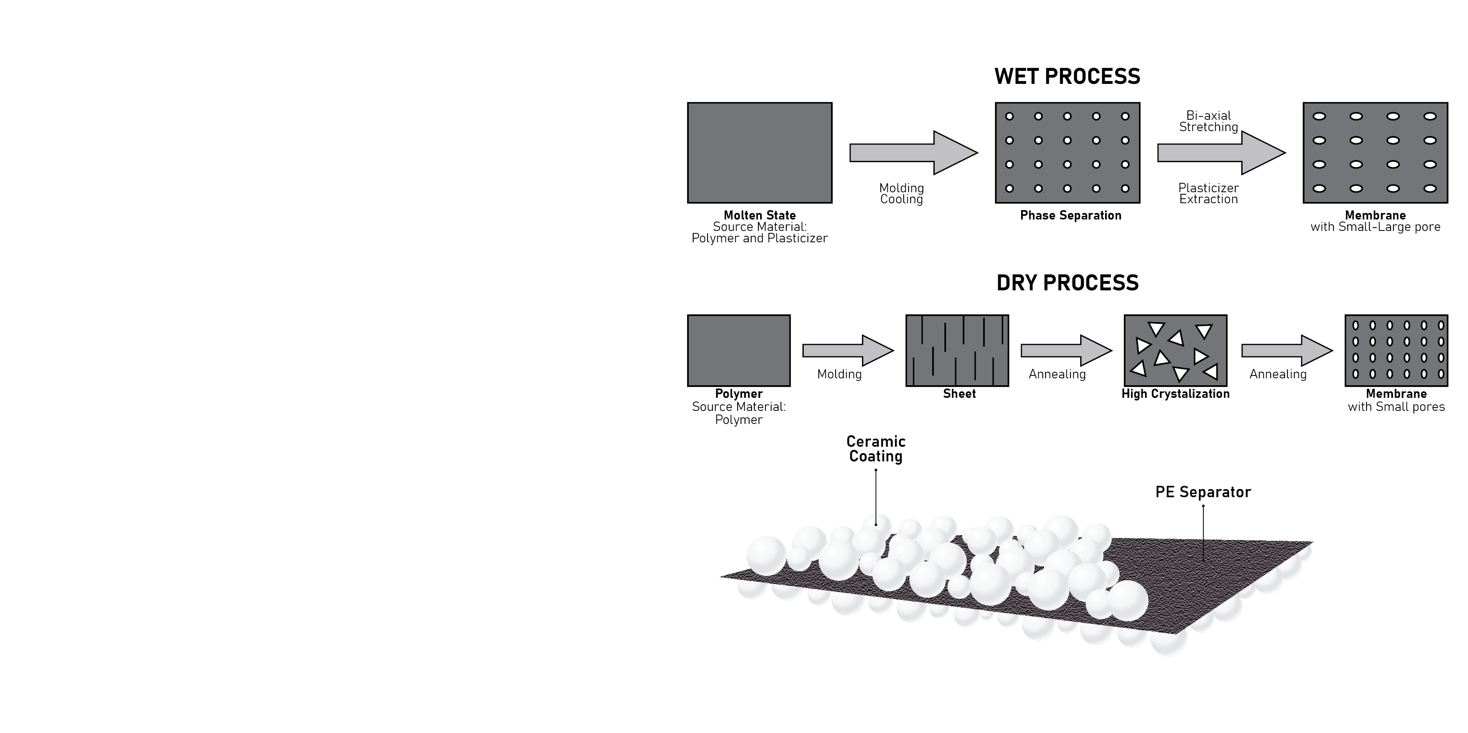
SEPARATOR DESIGN
Wet-laid separator
The wet-laid PE (Polyethylene) separators are becoming mainstream separator technology due to its improved material uniformity, strength, and electrolyte permeability, which are important to enhance battery’s cycle life and capacity.
Ceramic coating
On the surface of PP or PE separator, high heat resistance material such as Al2O3, SiO2, and Mg(OH)2 are applied to improve separator’s heat resistance and mechanical strength. The ceramic coating also neutralizes a small portion of the HF (Hydrogen Fluoride) created through the battery cycling, avoiding inner pressure accumulation.
https://www.researchgate.net/publication/329457210_Separator_Membranes_for_High_Energy-Density_Batteries/figures?lo=1
Notes:
Separators are used to ensure an electrical barrier exists between electrodes.
The mechanical strength and penetrability resistance of separators are key metrics for measuring the separators ability to resist damage in the mg process and during dendrite formation

Slide 23
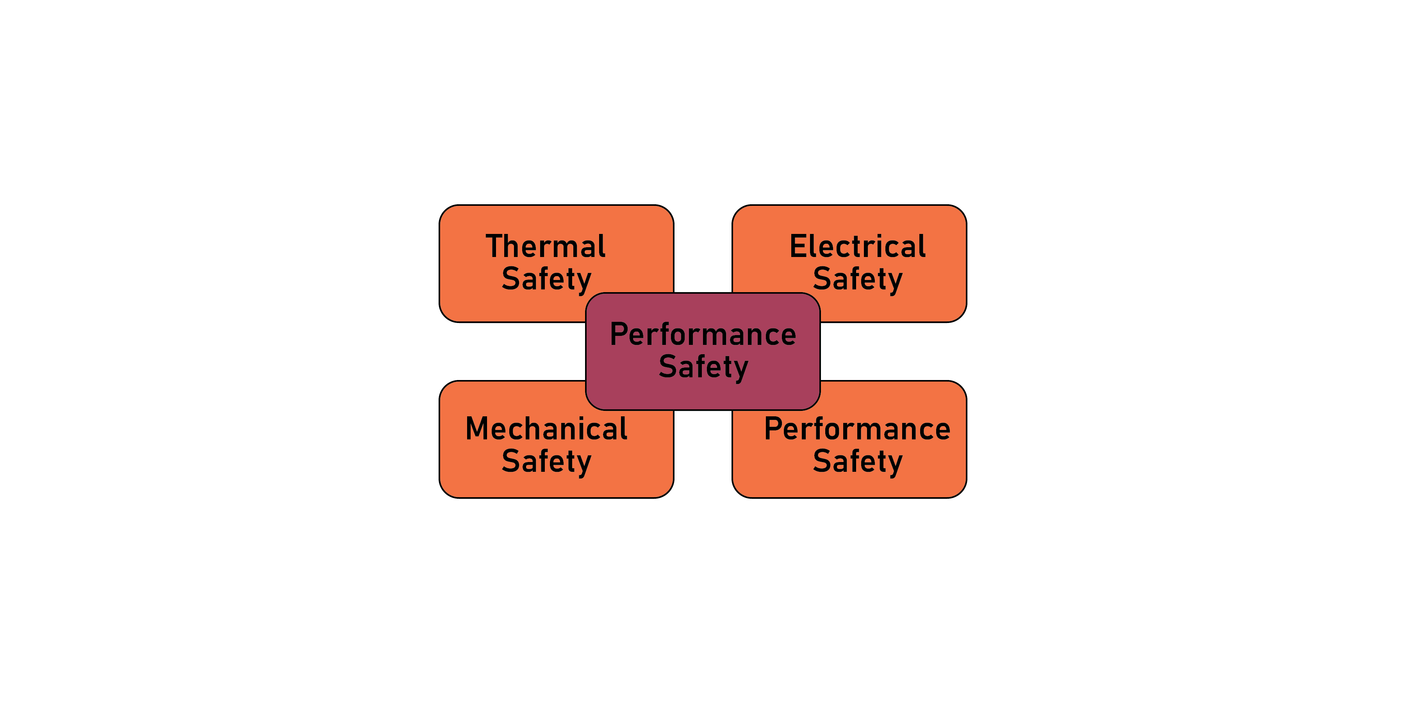
BATTERY MODULE DESIGN
Electrical Safety
High voltage resistance design
Short circuiting protection
Overcurrent fusing
Grounding
Touch-safe modules
Coolant isolation from electrical system
Thermal Safety
Thermal fuse links
Integrated thermocouples
Cell spacing
Flame retardant spacers
Mechanical Safety
Module structural strength
Moisture and dust protection
Seismic design
Adhesive bonding of cells
Performance Safety
Overcharge/overdischarge protection from BMS
Cooling fans and heat sinks
Notes:
Battery modules safety designs are also evolving.
Often the battery module is the ‘smallest’ serviceable part of the battery system and subjected to mechanical stresses during installation and maintenance.
Improvements in BMS integration and temperature monitoring also improves battery module safety.

Slide 24
Safety Trends – Battery Systems
Enclosure Trends
Controls and Integration

Slide 25
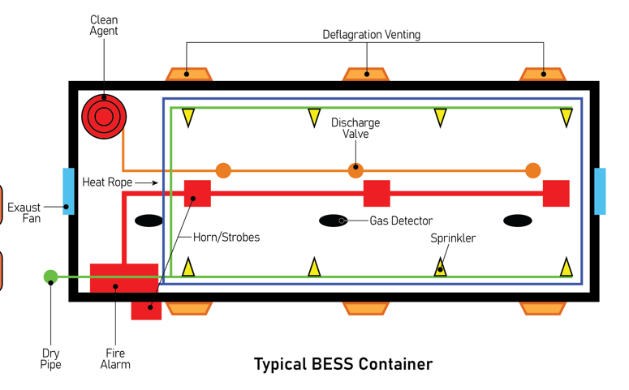
ENCLOSURE SAFETY TRENDS
Significant work for increasing the safety of lithium-ion battery systems has focused on the enclosure (container) and the integration of the subsystem that comprise the entire BESS
An externally accessible battery system ensures no occupied spaces within the enclosure.
Deflagration/ventilation systems provide a release path for any gas buildup or explosion,
Internal fire walls allow sectionalizing of the battery racks and critical systems.
Productization is the standardization of battery enclosures that are factory inspected and shipped to site in their near final form.
Large scale fire testing, UL9540 A.
Other observable trends include gas detection systems and liquid cooled systems
Top Five Trends:
Externally accessible enclosures
Deflagration/Explosion Ventilation
Internal Fire Walls and Barriers
Productization
Large Scale Fire Testing (ex. UL9540A)
Notes:
Externally accessible enclosures not only does this provide significant hazard mitigation for system operators, maintenance personnel or first responders, it can simplify permitting
Deflagration/venting directs the forces out of the container and away from personnel (often vertical)
Internal fire walls can ensure if a fire does occur in one section of the container, propagation throughput the unit is significantly delayed, allowing an appropriate response
Productization allows a fully testing and validated system to be shipped directly to site. This can help eliminate installation errors in the field and for mfg’s to deliver a ‘global product’ implementing all lessons learned
Large scale fire testing Assesses the thermal propagation behavior of a BESS when driven into thermal runaway allows accurate hazard mitigation measures to be implemented.
Other trends include gas detections systems heat and smoke detection systems and liquid cooled racks (more efficiently removing heat from the batteries)

Slide 26
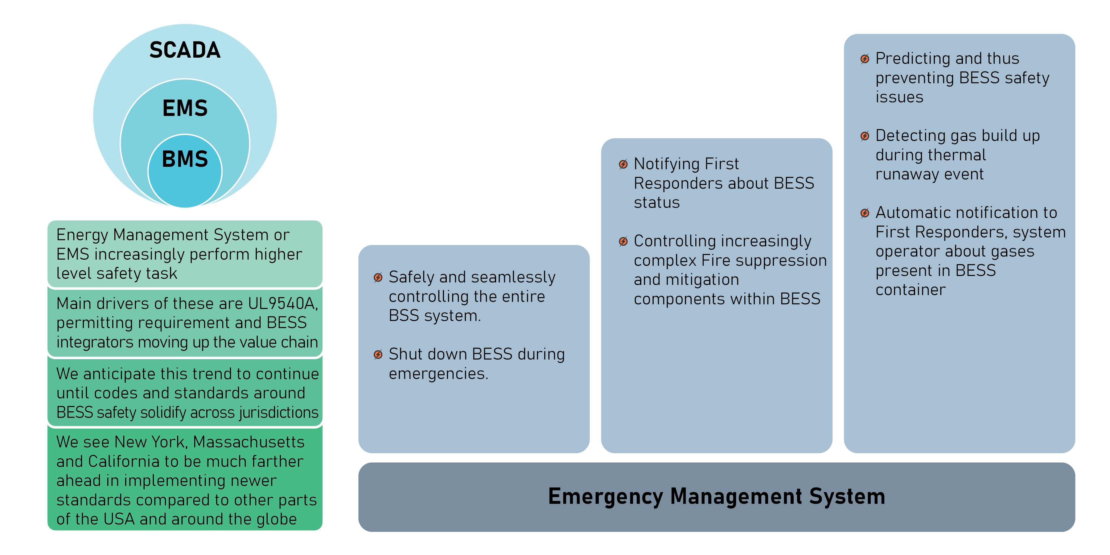
CONTROLS SYSTEM INTEGRATION
Notes:
Integration of the BMS into the EMS and other systems is another major lesson learned from ESS events.
Providing increased situational awareness around the existence of heat, smoke, activation of deflagration events and even gas detection ensures safe response for any event

Slide 27
Installation Safety Trends
Hazard Analysis
Large Scale Fire Testing

Slide 28
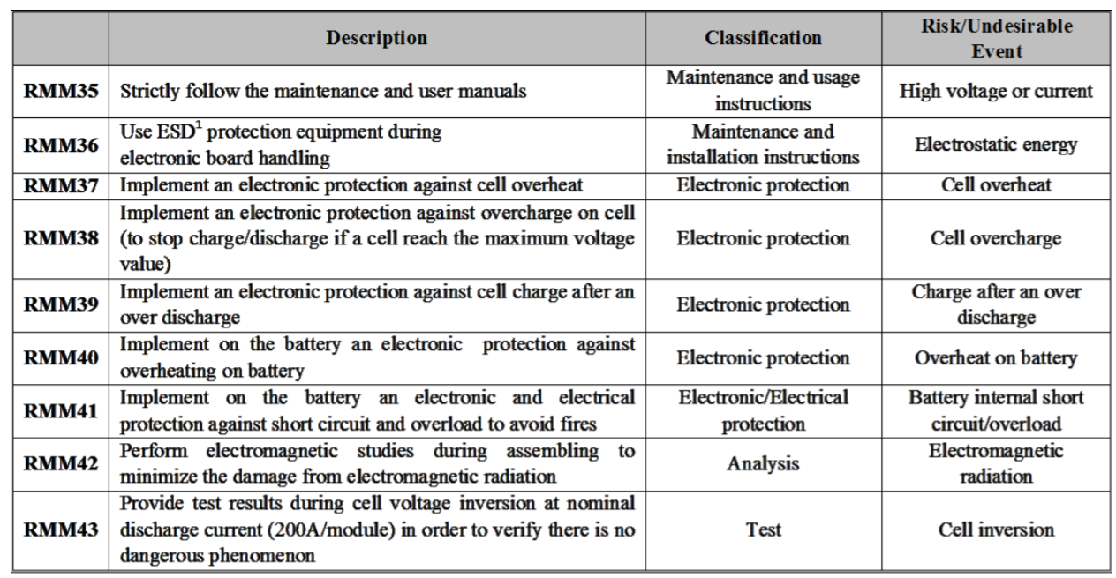
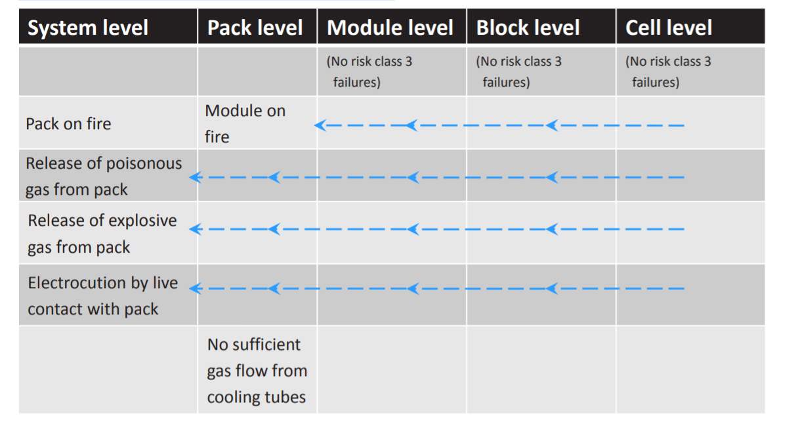
HAZARD ASSESSMENTS
A comprehensive “Hazard Assessment and Mitigation Plan” is increasingly being required by AHJ’s as part of the permitting process for battery storage systems.
The “Hazard Assessment” phase of the process is where the various risk of the battery system are identified for various stages of the project. These often include, at minimum:
Site Storage
Installation Onsite
Operation / Maintenance
Event Response
Decommissioning
Once the risks are identified, each is evaluated to determine the probability of occurrence and severity – just like an FMEA analysis.
Once these risks, their probabilities and severities are identified, mitigation measures are planned to reduce the overall occurrence/severity rating.
Many of these reports are proprietary for different BESS configurations.
Source: http://stabalid.eu-vri.eu/filehandler.ashx?file=13738
Notes:
read

Slide 29
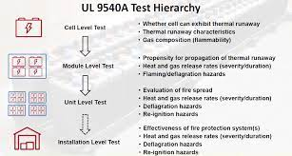
LARGE SCALE FIRE TESTING
As energy density continues to climb and the risks associated with battery-based energy storage systems are better understood, significant efforts have been placed into developing large-scale fire testing protocols and evaluation procedures.
UL 9540A is the de facto evaluation test in the United States, originally released in 2017 it is now on the 4th edition as of the last release in late 2019.
While not a standard, the testing protocol is designed to allow the comprehensive parameterization of a BESS that is initiated into thermal runaway.
Starting at the cell level and continuing through the ‘unit’ level and then ‘installation test’ level, various steps are required to complete the evaluation.
Cell-to-cell propagation is now required in module level testing per the 4th edition.
Source: UL
Notes:
Major trend is initiating thermal runaway and performing the testing in a ‘installed configuration’

Slide 30
Safety Standards
Energy Storage Safety Standards

Slide 31
ENERGY STORAGE SAFETY STANDARDS
Notes:
Some relevant safety stds

Slide 32
Thank You
Notes:
Some relevant safety stds we should all be aware of

Slide 33
Contact Information
Chris Wright
Executive Director
Energy Storage Practice Leader
Chris.wright@e3co.com
561.324.5031

